Slide 1

LRR Analytic Report
Team-3

Slide 2
Key Questions & Hypothesis
Questions to explore:
Where should be the company’s focus areas to drive continuous improvement on Battery’s LRR (Line Reject Rate) at system assembly factories?
Hypothesis per engineer’s knowledge:
Different PNs (Part Number) may have the significant difference in LRR performance
Different Suppliers and Factory locations may have the significant difference in LRR performance
Different product design (LOB, Watt-level) may have the significant difference in LRR performance
Temperature might be a significant factor to affect LRR performance at different geographic factories

Slide 3
Analytic Plan
Business Problem Statement
What’s should be the focus areas for company to drive continuous improvement on Battery’s LRR (Line Reject Rate) at system assembly factories?
Analytic Question definition
What is the correlation between LRR and other factors? Who has the significant impact to the LRR performance?
Data Collection
Data Source: The past 5 month data across all battery suppliers in world wide, over 14,000 line of records
Data Clean
Selected the only needed 12 columns, drop any N/A or Empty rows
P/Ns vs. Supplier: Bubble Chart
P/Ns vs. Factory: Bubble Chart
Month vs. Supplier: Trend Chart
Month vs. Factory: Trend Chart
LR vs. LOB: Pie Chart
LR vs. Watt: Pie Chart
LR vs. Factory: Pie Chart
LR vs. Supplier: Pie Chart
LRR vs. Geographic: Heat Map thru API Gmap
LRR vs. Temp: Weather API
Data Analytic & Result Interpretation
Conclusion & Presentation

Slide 4

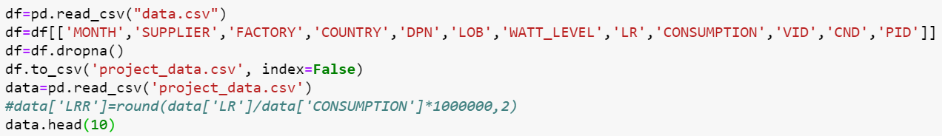
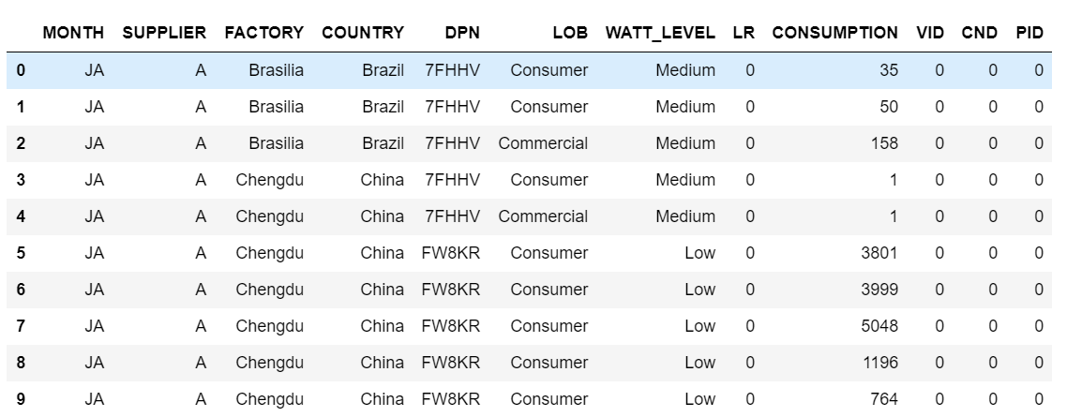
Data Cleaning

Slide 5
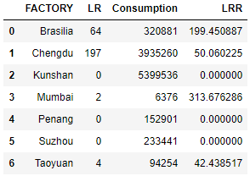
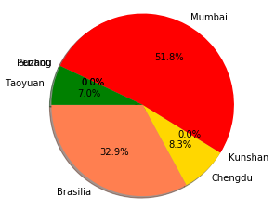
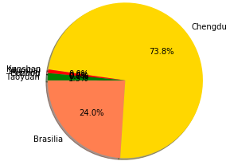
How different Factories (Location) contributed to the Line Reject in the past 5 months?
Reject Rate
Reject Amount

Slide 6
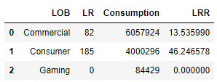
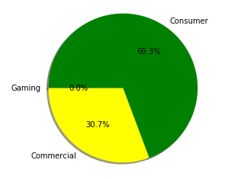
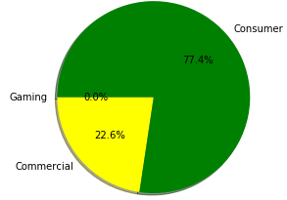
How different LOBs contributed to the Line Reject in the past 5 months?
Reject Rate
Reject Amount

Slide 7
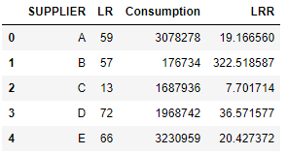
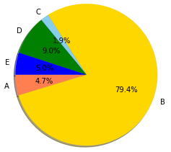
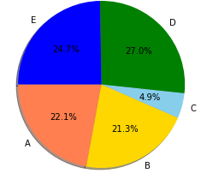
How different Suppliers contributed to the Line Reject in the past 5 months?
Reject Rate
Reject Amount

Slide 8
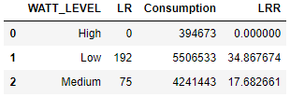
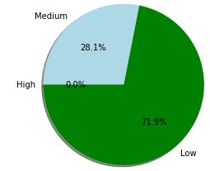
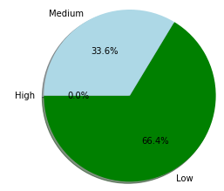
How different Design Type (Watt Level) contributed to the Line Reject in the past 5 months?
Reject Rate
Reject Amount

Slide 9
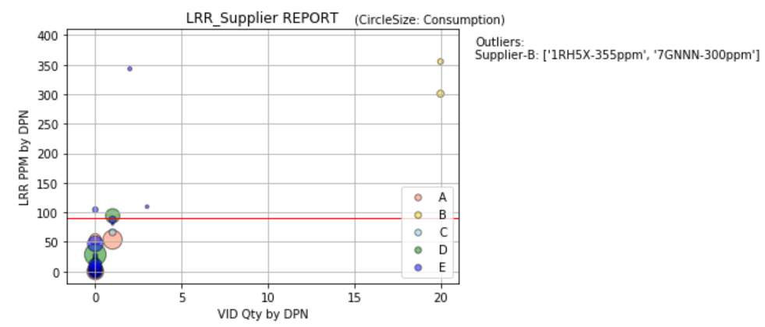
Does LRR performance has significant difference among different Part Numbers at different suppliers?
Interpretation:
Part Number 1RH5X and 7GNNN have a significant higher LRR performance at Supplier-B than others
Part Numbers with high LRR at Supplier-E, while they have very less VID qty (Vendor Incident Defect), these PNs could be ignored for further actions at this point and kept monitoring for its ongoing performance

Slide 10
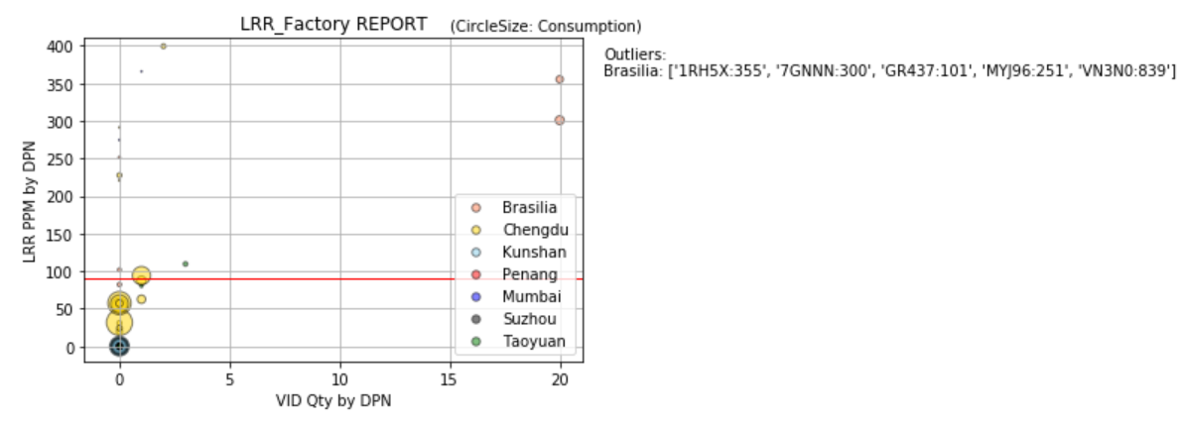
Does LRR performance has significant difference among different Part Numbers at different factory locations?
Interpretation:
Part Number 1RH5X, 7GNNN, VN3N0 have a significant higher LRR performance at Factory-Brasilia than others
Other Part Numbers have very less VID qty (Vendor Incident Defect), these PNs could be ignored for further actions at this point and kept monitoring for its ongoing performance.

Slide 11
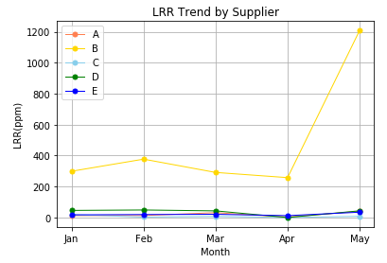
Does LRR performance has significant trend over time among different Suppliers?
Interpretation:
Supplier B has significant higher LRR than other suppliers from Jan to May, is in negative trend arrived from 300ppm in Jan to 1200ppm in May
All other suppliers kept in a stable level and within LRR target (90ppm) for every month

Slide 12
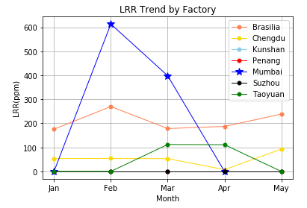
Interpretation:
Factory in Brasilia (Brazil) kept with higher LRR level than other locations over time from around 200pm, while there has no significant trend was observed.
Factory in Mumbai’s high LRR was caused by small consumption qty (2 defects out of total 6376), can be ignored at this point.
Does LRR performance has significant trend over time among different Factories?

Slide 13
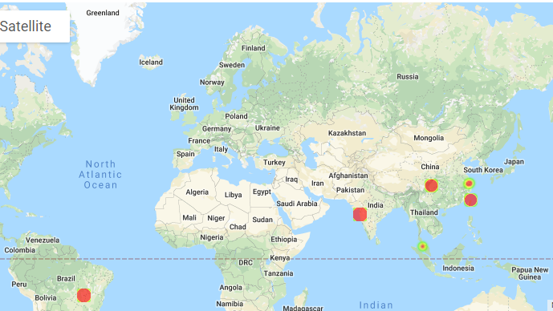
LRR Heat Chart by Geographic

Slide 14
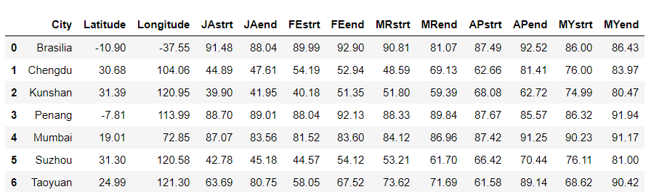
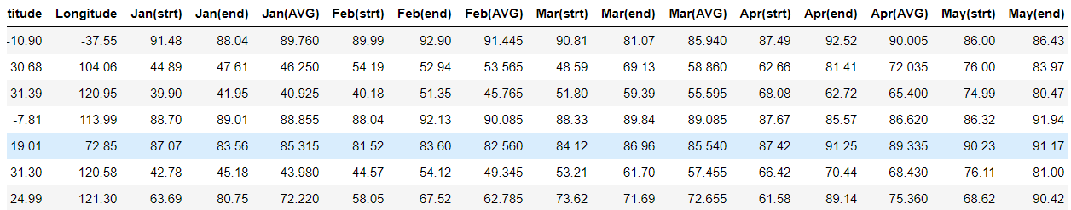
Dark Sky API before and after.

Slide 15

Analytic Conclusion
Part Number 1RH5X, 7GNNN, and VN3N0 have a significant higher LRR performance (over 300ppm) observed at Factory-Brasilia than others, suggest to prioritize these P/Ns for LRR continuous improvement
Supplier-B’s shipment had a all time higher LRR level (over 300ppm) than others, suggest to prioritize supplier-B for LRR continuous improvement
Brasilia (Brazil) factory had highest LRR (200ppm) than others, this city was also had the highest temperature which might affect to battery’s performance if without a proper inventory temp control. Suggest to focus on Brasilia factory’s inventory/process management process in next step to identify LRR reduction opportunity.

